Slide 1
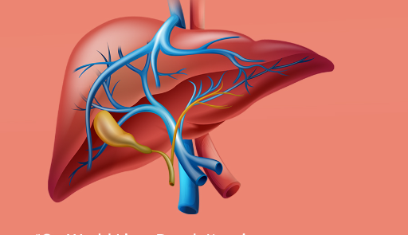
LIVER
DISEASE
CLASSIFICATION
BY:-
Macha Kedharnath
Paradesi Anisha Preethi
Priyanka More
Uzair Pandith
Akshata Shivarai
Vyshnavi Nallagopu
Shinde Sanjana Bhaskar

Slide 2
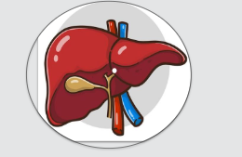
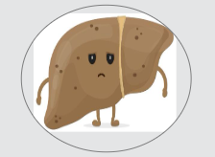
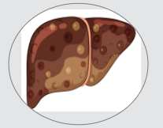
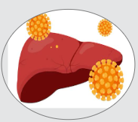
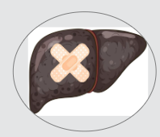
Business Objective
Liver disease includes a range of health conditions resulting from various factors that impact the normal functioning of the liver over an extended period. Effective treatment of Hepatitis C, a type of liver disease, can be significantly enhanced by accurately and timely predicting risk factors and severity, covering different stages like Fibrosis and Cirrhosis.
In this project, our objective is to create a model that will predict and diagnose patients with specific liver disease.
Category
No Disease
Suspected Disease
Fibrosis
Hepatitis C
Cirrhosis

Slide 3
Dataset Details
SN. | Attributes | Description
1. | AGE | Age(Years)
2. | SEX | 377 data from male and 238 data from female(male/female)
3. | ALB(Albumin) | Protein synthesized by the liver, contributes to immune function and acts as a binding agent for certain molecules (g/L)
4. | ALP(Alkaline Phosphatase) | An enzyme, plays an integral role in metabolism within the liver and development within the skeleton (u/L)
5. | ALT(Alanine Aminotransferase) | An important enzyme in the intermediary metabolism of glucose and protein (u/L)
6. | AST(Aspartate Aminotransferase) | An enzyme in amino acid metabolism found in liver, heart, skeletal muscle, etc. (u/L)
7. | BIL(Bilirubin) | Yellow pigment produced during the breakdown of red blood cells (μmol/L)
8. | CHE(Cholinesterase) | An enzyme, involved in the breakdown of acetylcholine, a neurotransmitter (100u/L)
9. | CHOL(Cholesterol) | A fatty substance produced by the liver and obtained from dietary source(mmol/L)
10. | CREA(Creatinine) | A waste product produced by muscles during normal metabolism(μmol/L)
11. | GGT(Gamma-Glutamyl Transference) | The liver enzyme, responsible for absorption of amino acids from the glomerular filtrate and from the intestinal lumen(u/L)
12. | PROT(Protein) | An essential macronutrient involved in various physiological processes, including tissue repair and immune function (g/L)

Slide 4
Data Science Methodology Flow Chart
Feedback
Business
Understanding
Deployment
Data
Requirements
Evaluation
Data
Understanding
Modeling
Data
Preparation

Slide 5
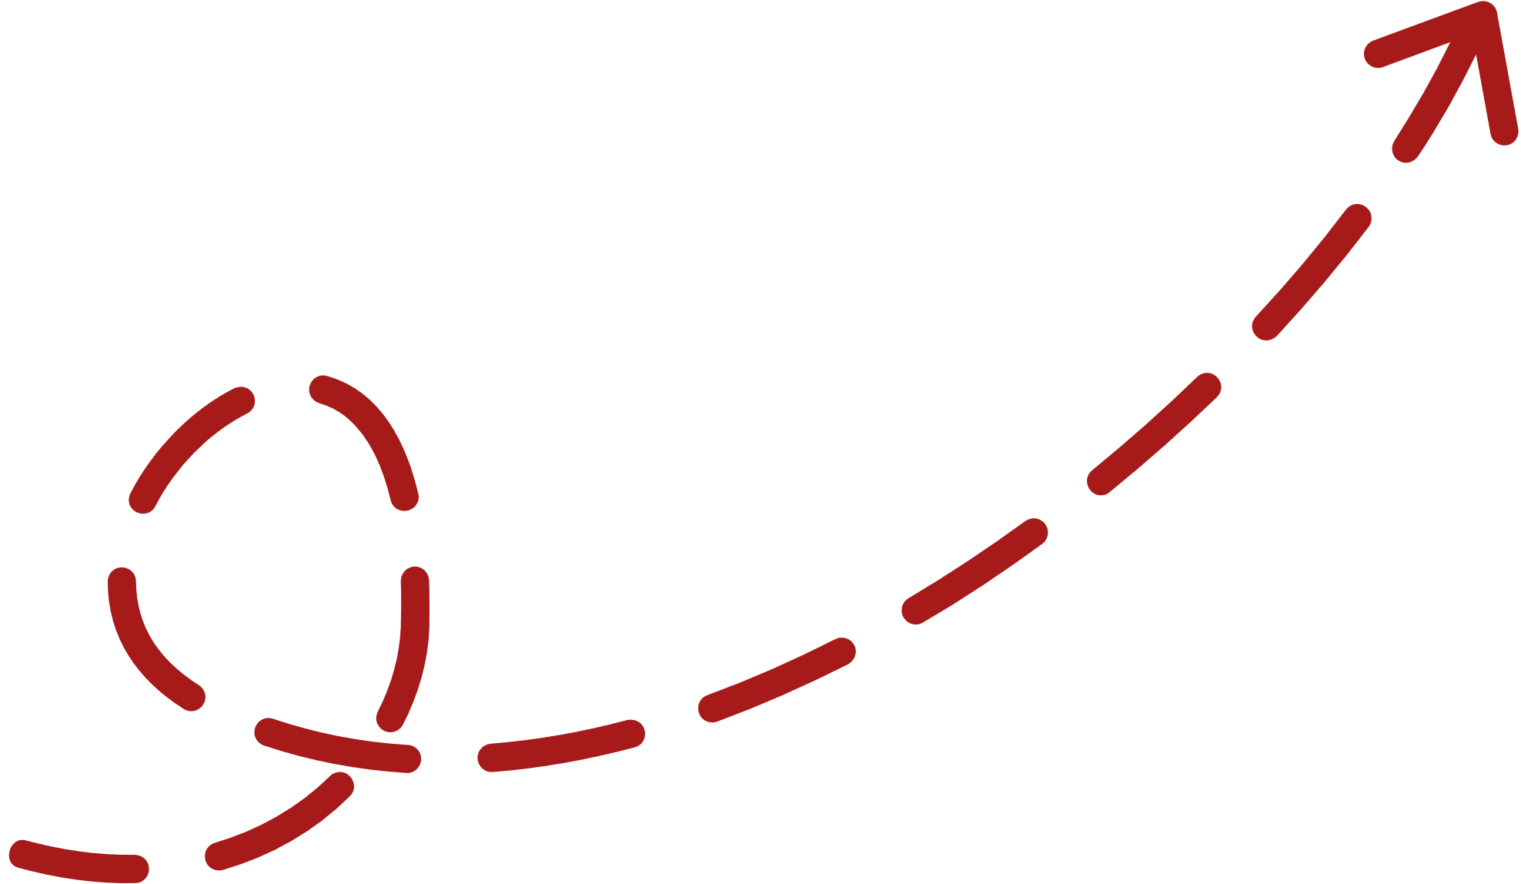

Exploratory Data Analysis (EDA) Steps
STEP 3
STEP 2
One Hot Encoding
STEP 4
Detection Of Outliers
Applied on Categorical Feature ‘Sex’
Label Encoding
Treating the Outliers
Applied On Categorical Feature 'Category’
STEP 1
STEP 5
Dealing With The Null Value
Standard Scaling
Applied on Cleaned Dataset For Standardization & enhance model performance.
Replacing With Median Values

Slide 6
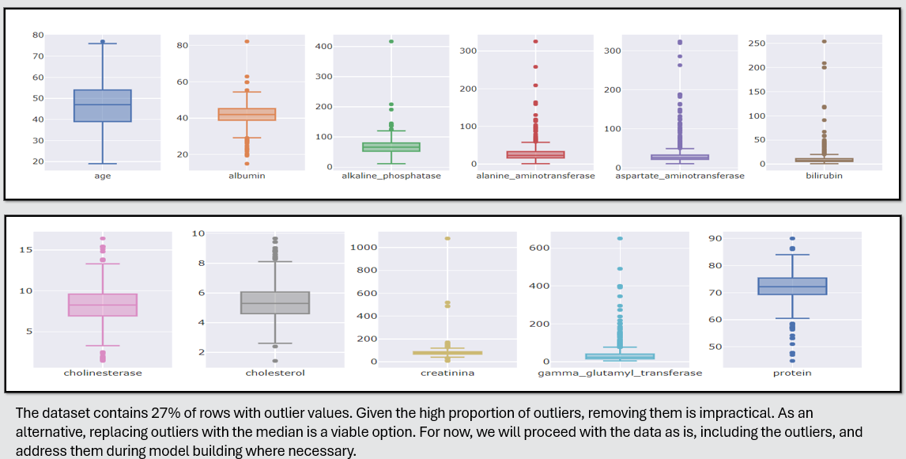
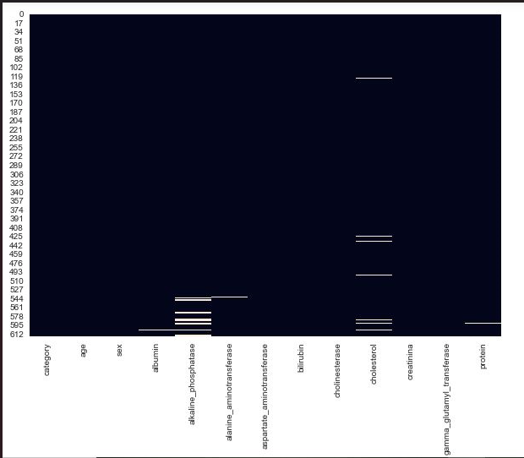
Visualization For Null Values & Outliers
Null Values
Outliers

Slide 7
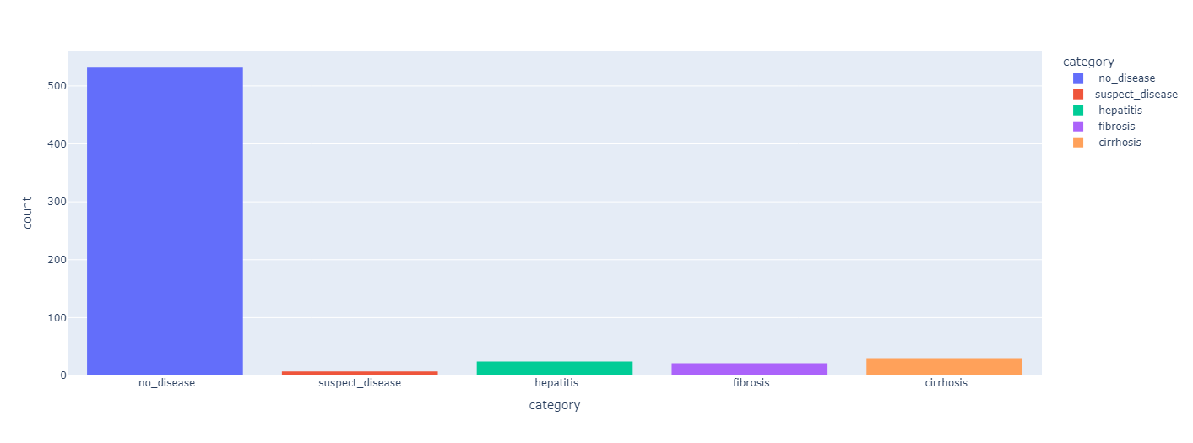
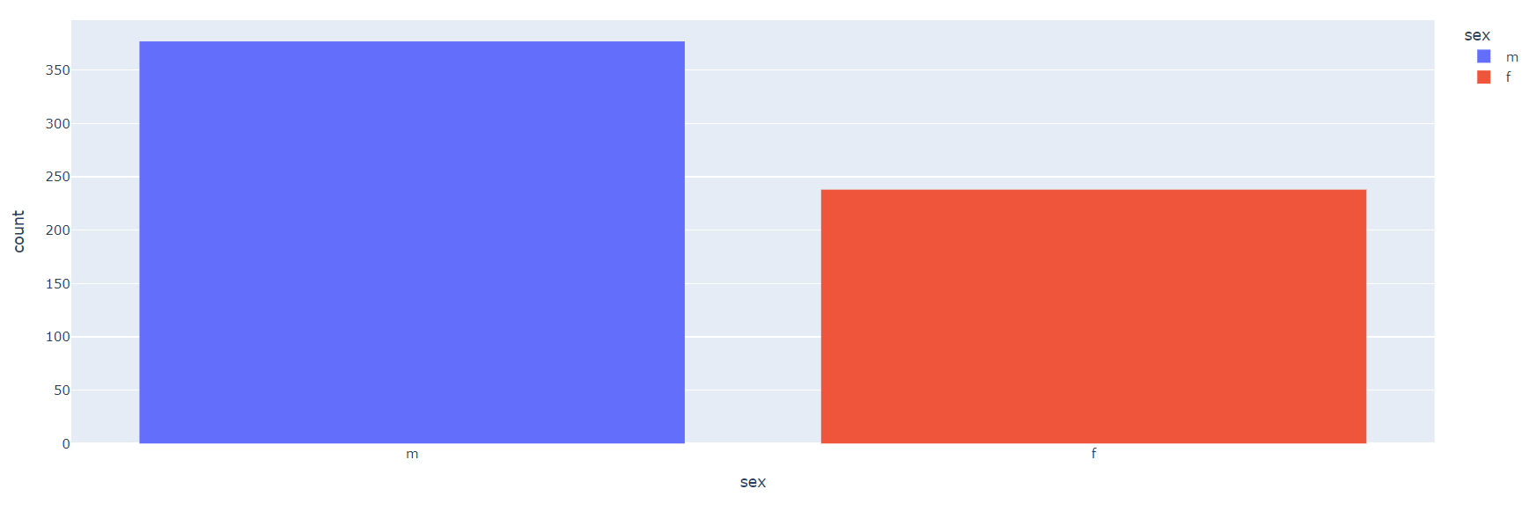
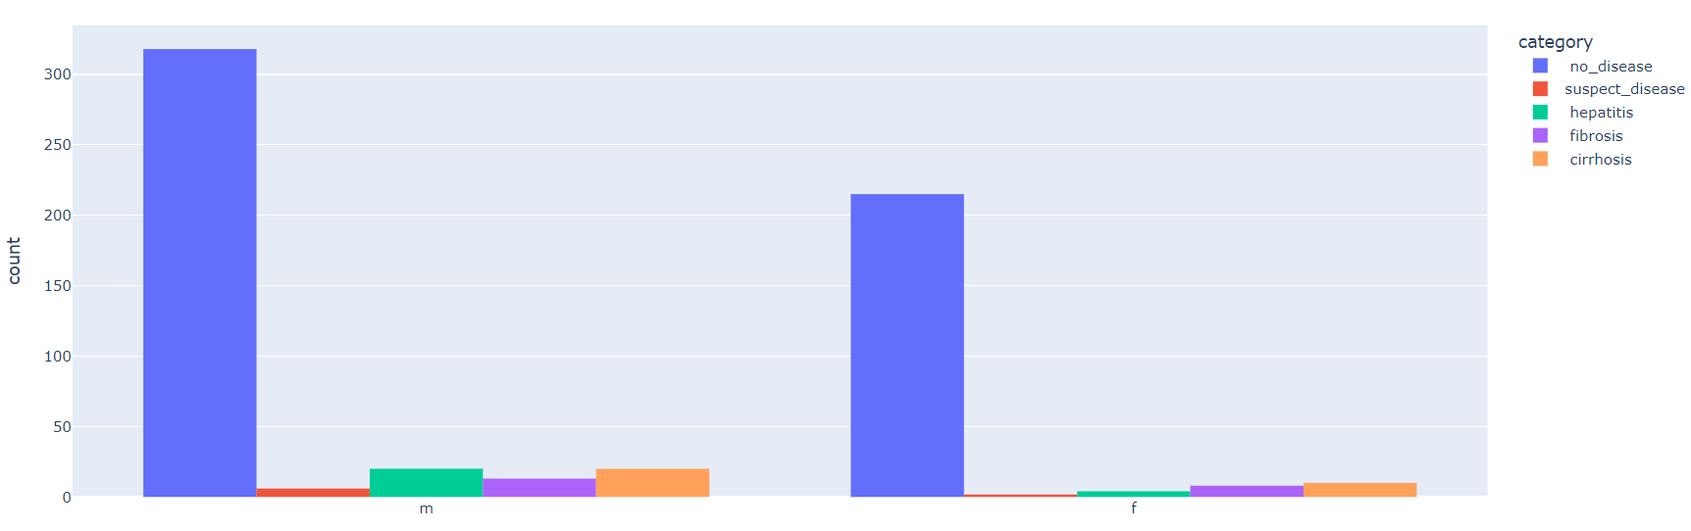
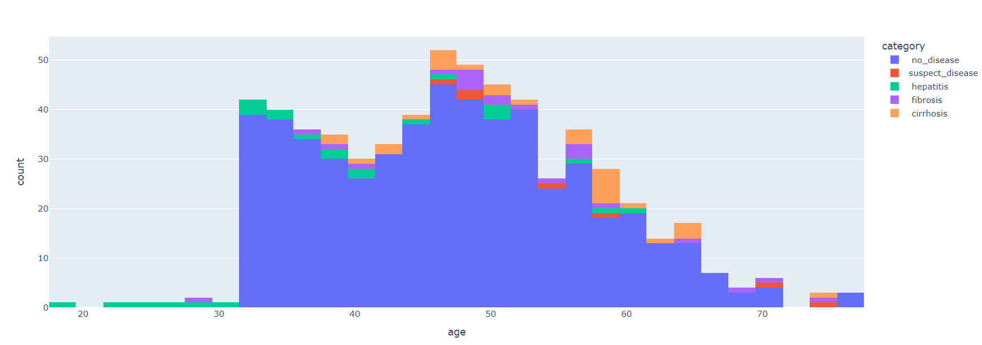
Visualization For Category & Gender
Category
Gender
Gender Wise Category
Age Wise Category

Slide 8
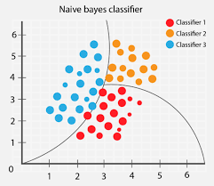
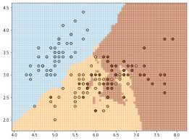
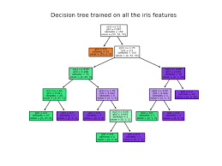
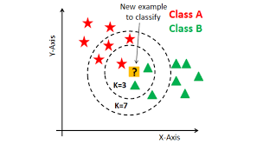
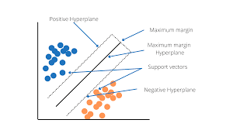
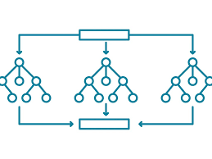
Models
Naïve Bayes
Logistic Regression
Decision Tree
K-Nearest Neighbors
Support Vector Machine
Random Forest

Slide 9
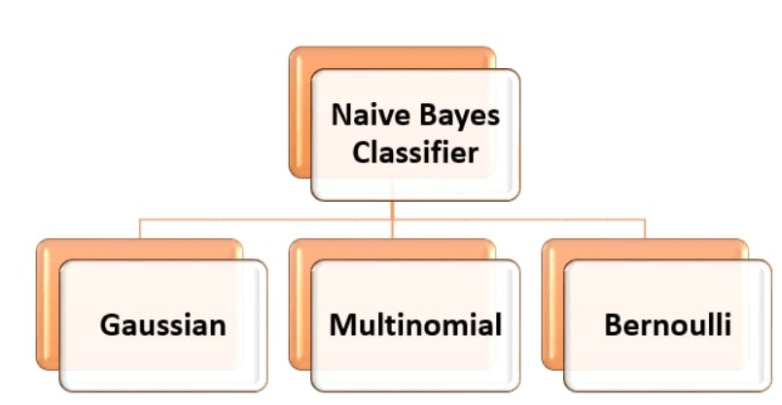
Naive Bayes Classifier
Naive Bayes Classifier
The Naive Bayes classifier is a supervised machine learning algorithm that is used for classification tasks such as text classification.
They use principles of probability to perform classification tasks.
Naïve Bayes is also known as a probabilistic classifier since it is based on Bayes’ Theorem.
Types of Naive Bayes Classifier
Classification report of Naïve Bayes Model
 | Precision | Recall | F-1 score | Support
Cirrhosis | 0.83 | 0.71 | 0.77 | 7
Fibrosis | 0.20 | 1.00 | 0.33 | 2
Hepatitis | 0.00 | 0.00 | 0.00 | 4
No Disease | 0.98 | 0.93 | 0.95 | 108
Suspect Disease | 1.00 | 0.50 | 0.67 | 2
Accuracy |  |  | 0.88 | 123
Macro Avg | 0.60 | 0.63 | 0.54 | 123
Weighted Avg | 0.93 | 0.88 | 0.90 | 123
Accuracy Score
Train | Test
0.92 | 0.87

Slide 10



SMOTE ALGORITHM
SMOTE ALGORITHM
SMOTE ( Synthetic Minority Oversampling Technique) is a preprocessing technique used to address a class imbalance in a dataset.
It is a statistical technique that creates synthetic samples to balance imbalanced datasets.
It is an oversampling technique where the synthetic samples are generated for the minority class.
This algorithm helps to overcome the overfitting problem posed by random oversampling.
It focuses on the feature space to generate new instances with the help of interpolation between the positive instances that lie together
It aims to balance class distribution by randomly increasing minority class examples by replicating them.
The Function of Smote follow the steps:
Increase minority
Focus on the minority
Identify the Imbalance
Create synthetic samples

Slide 11
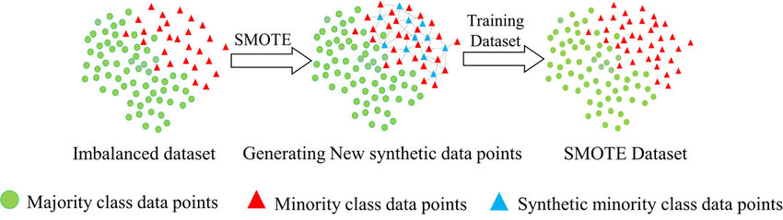
SMOTE ALGORITHM
Work Flow Of SMOTE ALGORITHM

Slide 12
Naive Bayes Classifier
Naïve Bayes classification and accuracy after balancing the dataset.
Classification report of Naïve Bayes Model
 | Precision | Recall | F-1 score | Support
Cirrhosis | 0.94 | 0.85 | 0.89 | 118
Fibrosis | 0.76 | 0.79 | 0.78 | 101
Hepatitis | 0.77 | 0.79 | 0.78 | 99
No Disease | 0.90 | 0.89 | 0.89 | 98
Suspect Disease | 0.94 | 1.00 | 0.97 | 117
Accuracy |  |  | 0.87 | 533
Macro Avg | 0.86 | 0.86 | 0.86 | 533
Weighted Avg | 0.87 | 0.87 | 0.87 | 533
Accuracy Score
Train | Test
0.86 | 0.86

Slide 13
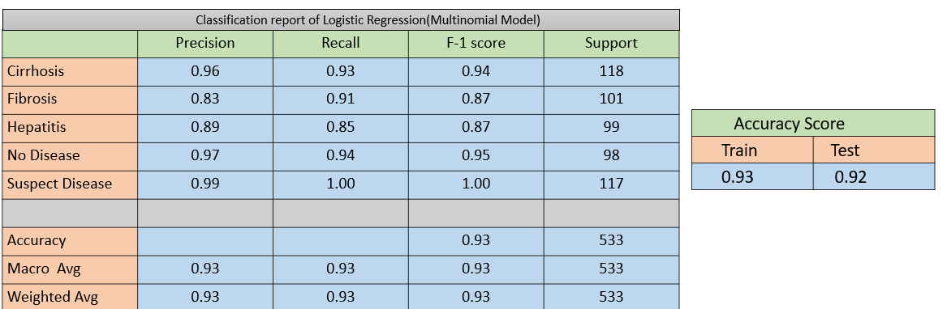
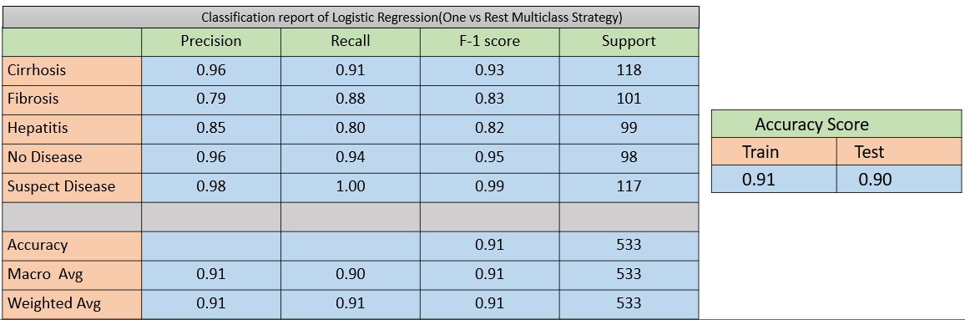
Logistic Regression
Logistic Regression
Logistic Regression models automatically handle binary classification problems in which the target vector(label column) has only two classes.
It is used for binary classification where it takes input as independent variables and produces a probability value between 0 &1.
It predicts the output of a categorical dependent variable.
Multinomial
One vs Rest

Slide 14
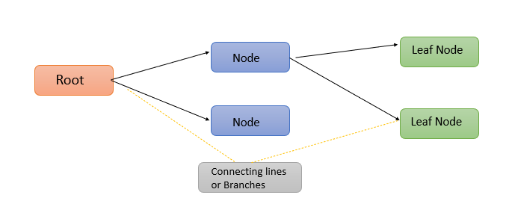
Decision Tree
Decision Tree
It is a flowchart-like tree structure, where each internal node denotes a test on an attribute, each branch represents an outcome of the test, and each leaf node holds a class label
A decision tree is a classifier that helps make decisions.
It is depicted as a rooted tress filled with nodes & incoming edges.
Classification report of Decision tree
 | Precision | Recall | F-1 score | Support
Cirrhosis | 0.97 | 0.94 | 0.96 | 118
Fibrosis | 0.92 | 0.97 | 0.95 | 101
Hepatitis | 0.90 | 0.96 | 0.93 | 99
No Disease | 0.97 | 0.88 | 0.92 | 98
Suspect Disease | 0.99 | 1.00 | 1.00 | 117
Accuracy |  |  | 0.95 | 533
Macro Avg | 0.95 | 0.95 | 0.95 | 533
Weighted Avg | 0.95 | 0.95 | 0.95 | 533
Accuracy Score
Train | Test
0.97 | 0.95

Slide 15
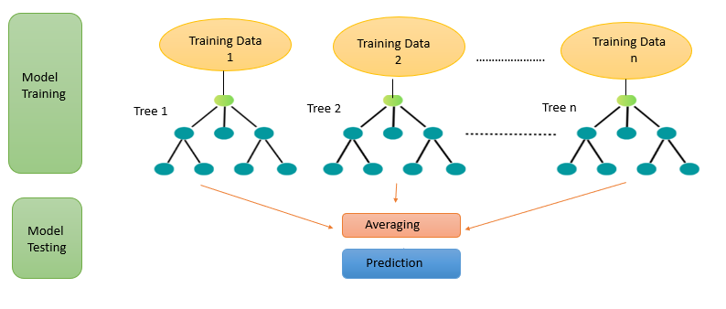
Random Forest
Random Forest
Random forest can used for both classification and regression problems.
It uses multiple decision trees to make predictions
Classification report of Random Forest
 | Precision | Recall | F-1 score | Support
Cirrhosis | 1.00 | 1.00 | 1.00 | 118
Fibrosis | 1.00 | 1.00 | 1.00 | 101
Hepatitis | 0.98 | 1.00 | 0.99 | 99
No Disease | 1.00 | 0.98 | 0.99 | 98
Suspect Disease | 1.00 | 1.00 | 1.00 | 117
Accuracy |  |  | 1.00 | 533
Macro Avg | 1.00 | 1.00 | 1.00 | 533
Weighted Avg | 1.00 | 1.00 | 1.00 | 533
Accuracy Score
Train | Test
1.0 | 0.99

Slide 16
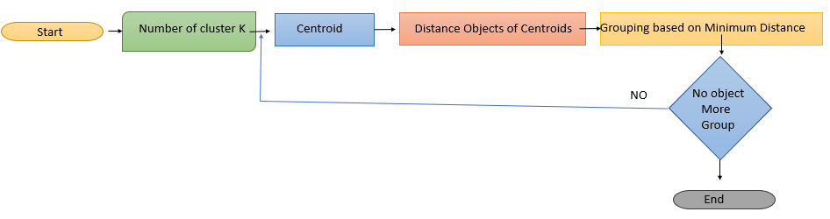
K-Nearest Neighbors(KNN)
K-Nearest Neighbors (KNN)
It can used for both classification and regression tasks.
It belongs to the category of supervised learning, meaning it learns from labeled data to make predictions on new, unseen data.
KNN algorithm stores all the variable’s data and classifies a new data point based on the similarity.
Classification Report KNN
 | Precision | Recall | F-1 score | Support
Cirrhosis | 1.00 | 0.99 | 1.00 | 118
Fibrosis | 0.96 | 0.99 | 0.98 | 101
Hepatitis | 0.97 | 1.00 | 0.99 | 99
No Disease | 1.00 | 0.97 | 0.97 | 98
Suspect Disease | 0.99 | 1.00 | 1.00 | 117
Accuracy |  |  | 0.98 | 533
Macro Avg | 0.98 | 0.98 | 0.98 | 533
Weighted Avg | 0.98 | 0.98 | 0.98 | 533
Accuracy Score
Train | Test
0.98 | 0.98

Slide 17
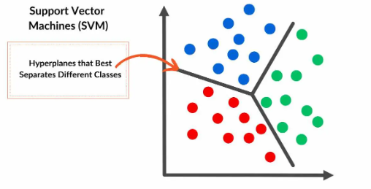
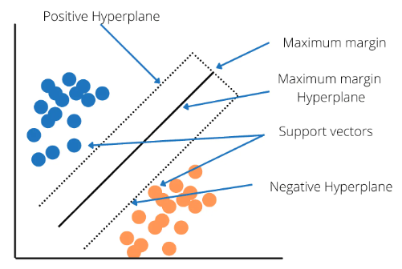
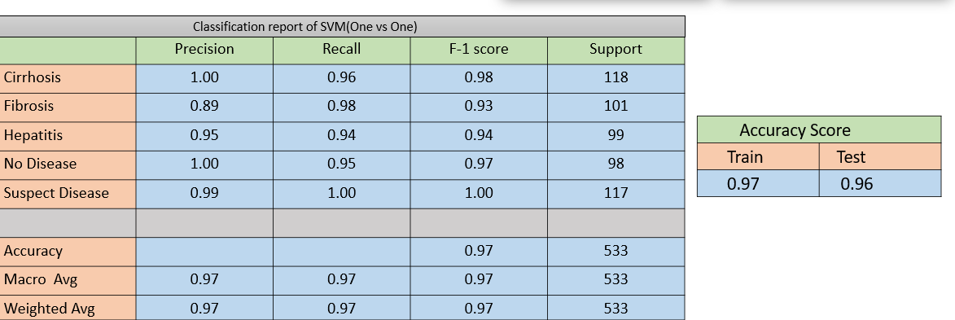
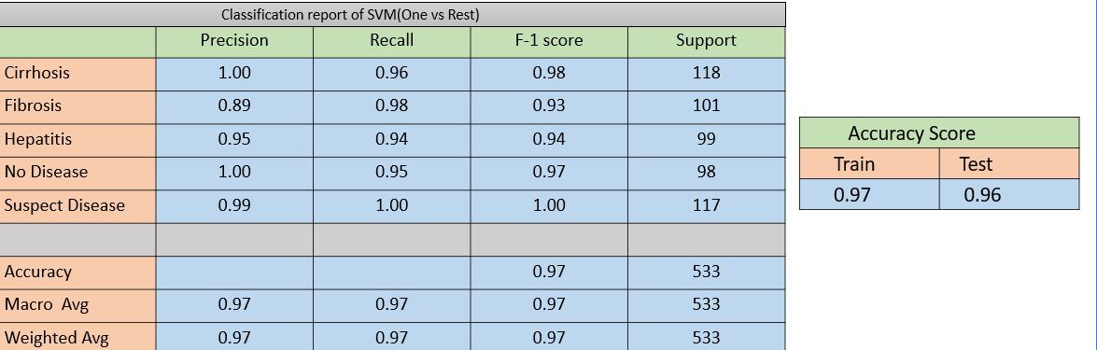
SVM(Support Vector Machine)
SVM(Support Vector Machine)
It is a supervised machine-learning algorithm that classifies data by finding an optimal line or hyperplane that maximizes the distance between each class in an N-dimensional space.
When dealing with multi-class classification using Support Vector Machines(SVM), primary strategies are commonly employed.
One vs Rest
One vs One

Slide 18
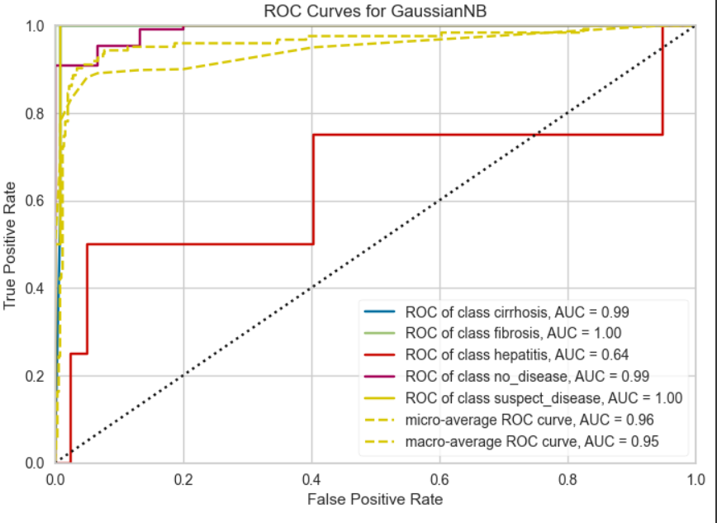
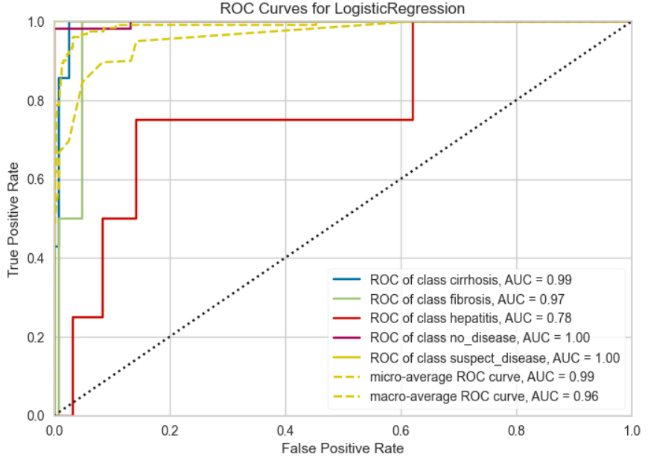
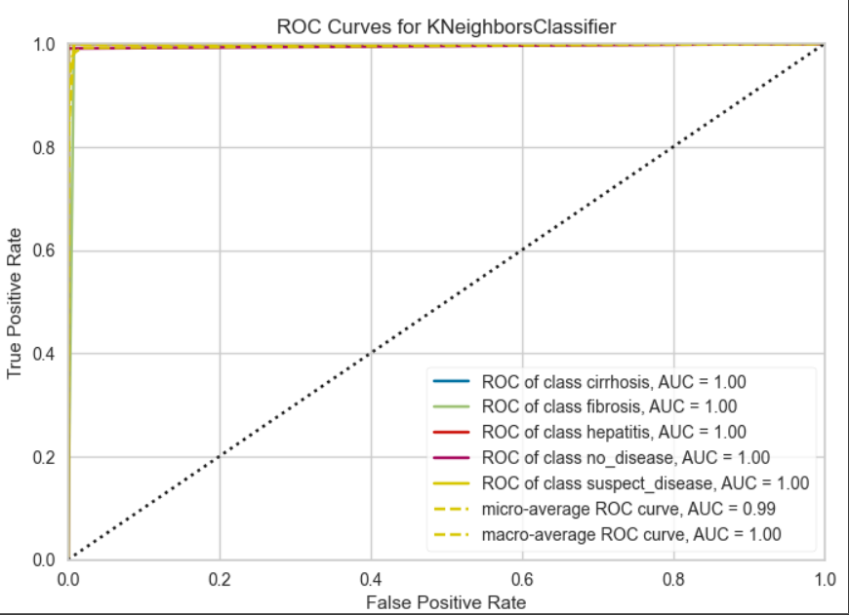
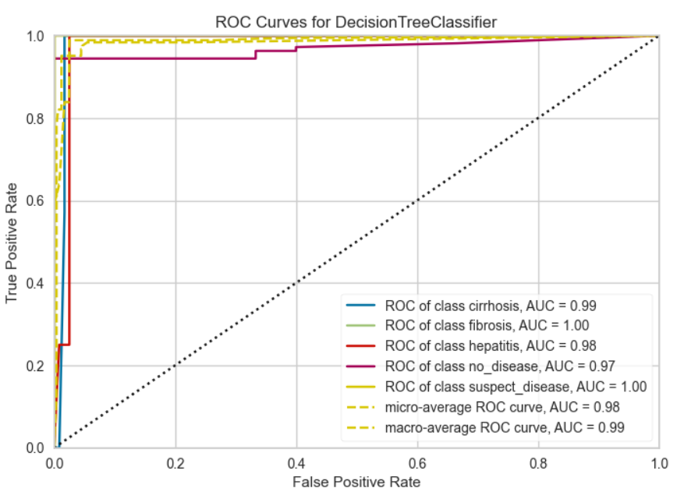
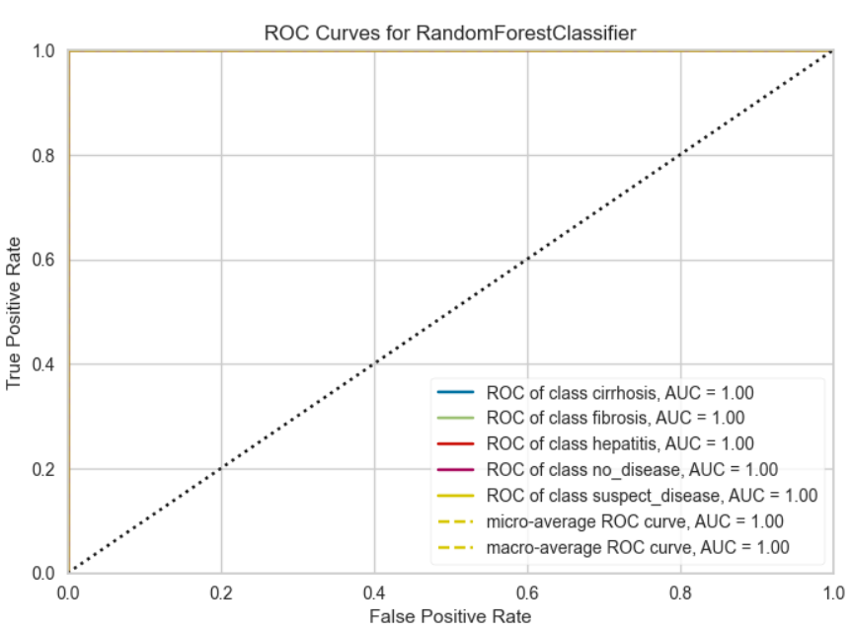
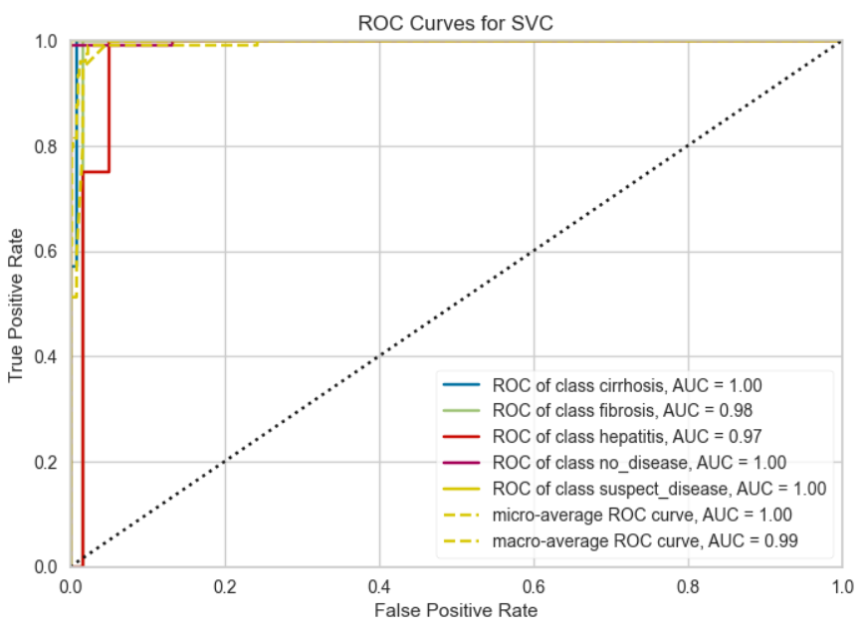
ROC Curve
ROC Curve
A receiver operating characteristics(ROC) curve is a graph that shows how well a binary classifier model performs at different threshold values.
It is created by plotting the True Positive Rate(TRP) against the False Positive Rate for each threshold.
It is useful for assessing the performance of diagnostic tests. The area under the ROC curve is a measure of accuracy, or how well an algorithm can distinguish between two groups.
KNN
Random Forest
Logistic Regression
Decision Tree
SVC
Gaussian NB

Slide 19
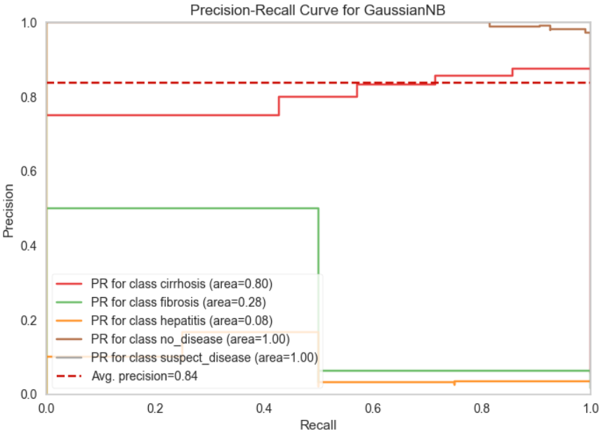
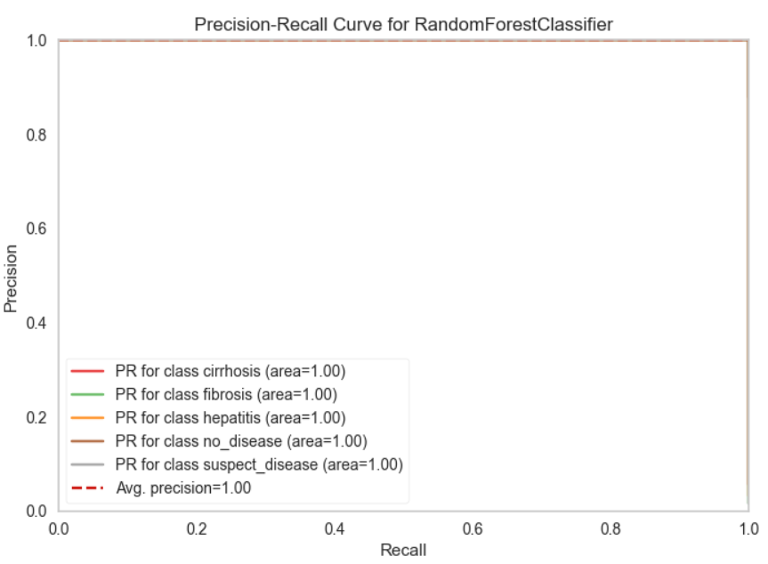
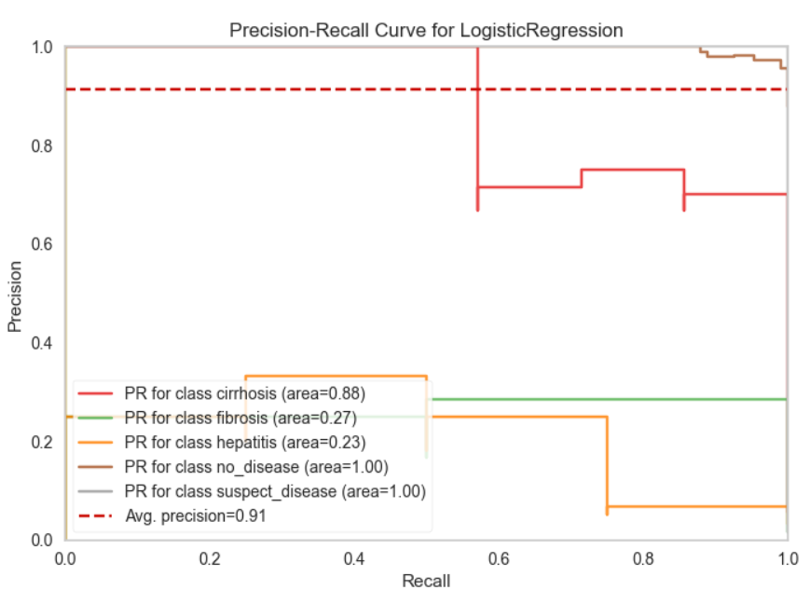
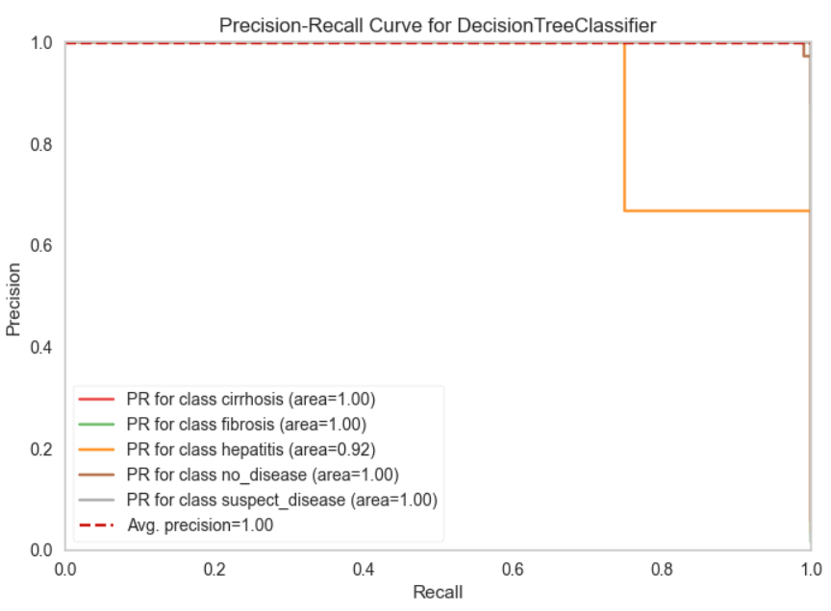
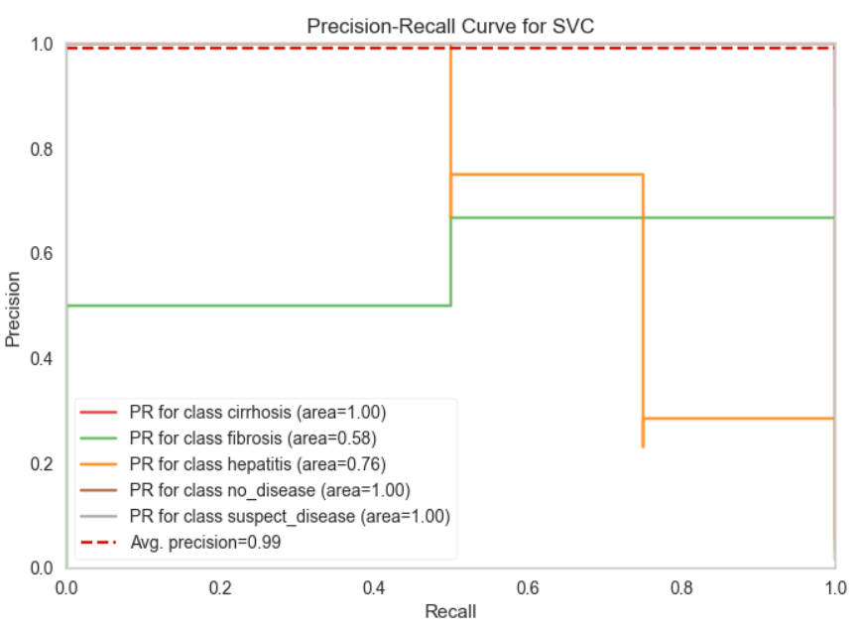
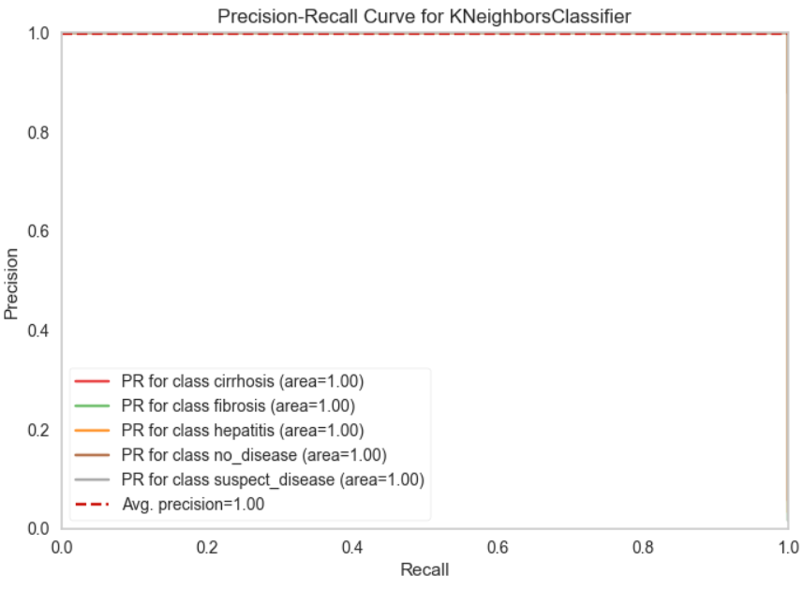
AUPRC CURVE
AUPRC
The area under the precision-recall curve (AUPRC) is used as a metric for comparing the performance of evaluated anomaly detection methods.
Higher is better, and the closer you are to 1.0, the closer you are to solving the problem.
KNN
Random Forest
Logistic Regression
Decision Tree
SVC
GaussianNB

Slide 20
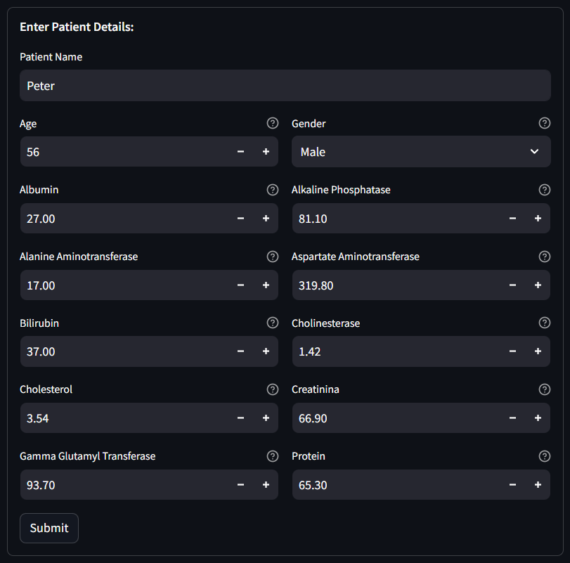
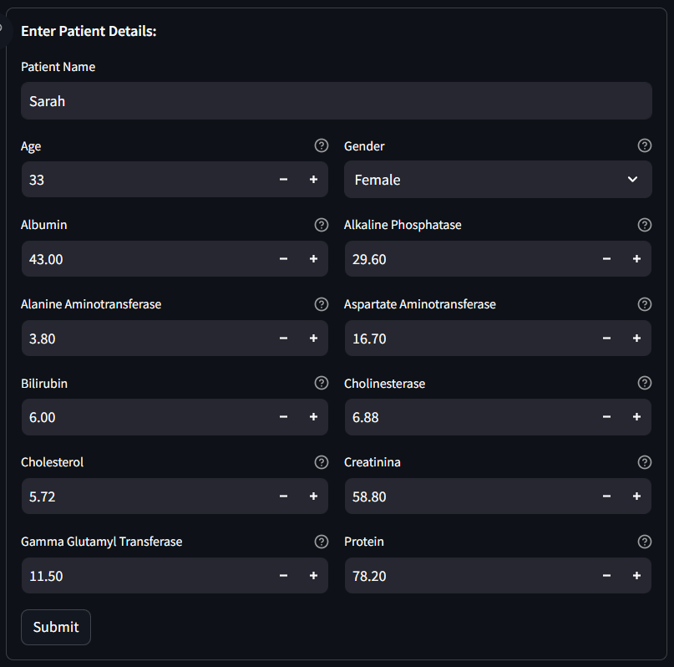
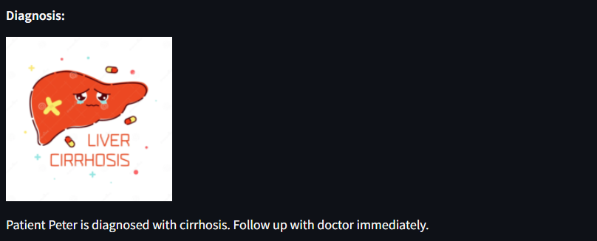
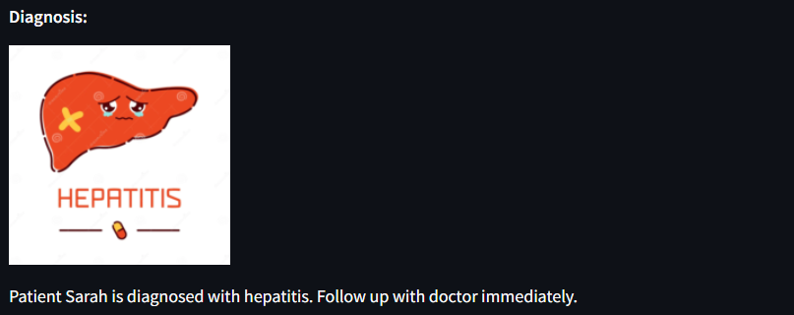
Deployment
Streamlit
It is a free & open-source app framework for creating and sharing visually appealing machine learning and data science web apps.
It is a Python-based library primarily for machine learning developers.

Slide 21
Challenges
Imbalance :
An imbalanced dataset is a dataset where the number of examples for each class is not evenly distributed. In other words, one class is more common than the other, and is called the majority class, while the less common class is called the minority class.
Imbalanced data can be a problem for machine learning algorithms because they can become biased towards the majority class and perform poorly on the minority class. This can lead to biased results and affect the overall accuracy of the model.
This imbalance led to a decrease in precision and recall for some classification categories, resulting in a decline in the model's overall performance.
SMOTE is a popular oversampling technique used to address class imbalance in machine learning datasets. It's particularly effective when dealing with datasets where the minority class is significantly underrepresented.
Evaluation Curves :
The AUC-ROC curve, or Area Under the Receiver Operating Characteristic curve, is a graphical representation of the performance of a binary classification model at various classification thresholds.
A precision-recall (PR) curve is a plot that gauges machine learning model performance by using precision and recall, which are performance metrics that evaluate the quality of a classification model.
Both the precision-recall curve and the ROC curve are available within scikit-learn, which can only be used for binary classification. This leads to the challenge of finding a way to apply them to multi-class classification.
Yellowbrick is a powerful Python library that provides visual analysis tools for machine learning models. It extends the scikit-learn API, making it easy to incorporate visualization into your existing workflows.
Yellowbrick is an open-source project licensed under the MIT License.

Slide 22

THANK YOU

